Slide 1
Stochastic Process
B.SC CSIT 3rd Semester
Central Campus of Technology

Slide 2
Definition:
Stochastic processes are mathematical models used to describe the behavior of random events or phenomena that change over time. They are often used in various fields such as finance, physics, engineering, and biology to analyze and understand the uncertain nature of real world systems.
In simple terms, you can think of a stochastic process as a sequence of random events that occur in a particular order. These events can be influenced by chance or probability, and their outcome at any given time is not entirely predictable. The process itself evolves or changes over time based on the occurrence of these random events.

Slide 3
Conti……………………..
For example, imagine you are tracking the number of people entering a store every hour. The number of customers can vary randomly from hour to hour, and it is impossible to know the exact number of customers that will enter the store in any given hour. However, by studying the patterns and statistics of these random arrivals, you can develop mathematical models that describe the behavior of this stochastic process.
Stochastic processes provide a way to study and analyze the statistical properties of random phenomena over time. They allow us to make predications about the future behavior of the process based on its past behavior and the underlying probabilities involved.

Slide 4
Classification:
Stochastic processes can be classified into different types based on their characteristics and properties. Here are some common classifications:
Discrete-Time vs. Continuous- Time
Markov vs. Non. Markov
Stationary vs. Non-Stationary:
Gaussian vs. Non-Gaussian
Homogeneous vs. Non-homogeneous
These classification help in understanding the properties and behaviors of different stochastic process, allowing researchers and practitioners to choose appropriate models and technique for analyzing and predicting their outcomes.

Slide 5
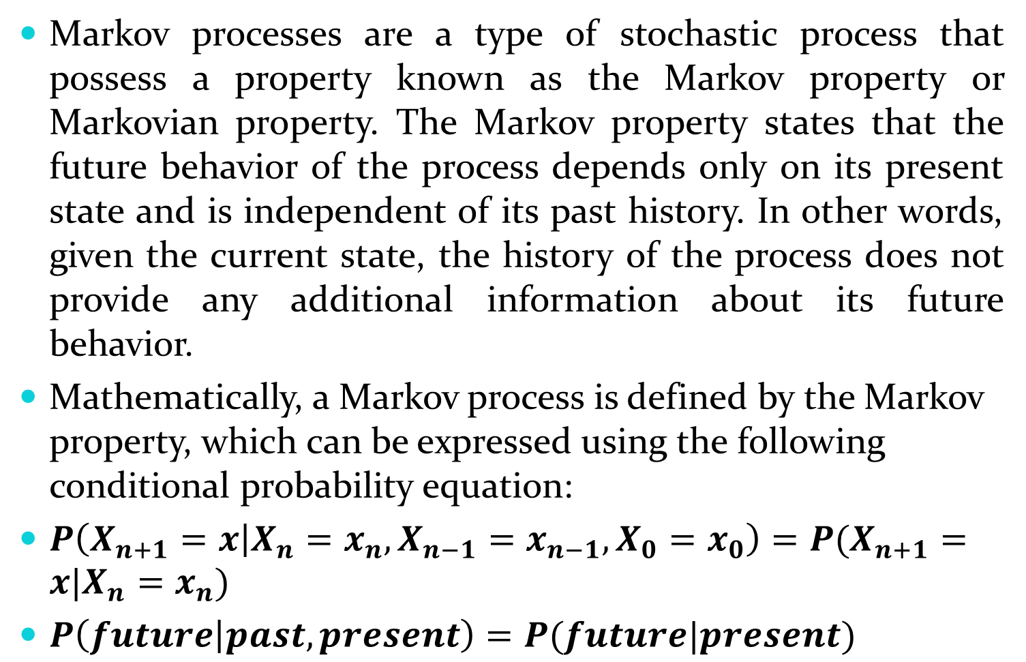
Markov Processes:
Markov processes are a type of stochastic process that possess a property known as the Markov property or Markovian property. The Markov property states that the future behavior of the process depends only on its present state and is independent of its past history. In other words, given the current state, the history of the process does not provide any additional information about its future behavior.
Mathematically, a Markov process is defined by the Markov property, which can be expressed using the following conditional probability equation:
$P\left(X_{n+1}=x | X_{n}=x_{n}, X_{n−1}=x_{n−1}, X_{0}=x_{0}\right)=P(X_{n+1}=x|X_{n}=x_{n})$
$P\left(future | past, present\right)=P(future|present)$

Slide 6
Conti…………
The Markov processes have many applications in various fields. For example, in finance, they are used to model stock prices and asset prices. In physics, they are used to describe the behavior of particles in random motion. In computer science, they are used in machine learning algorithms, such as hidden Markov models.

Slide 7
Markov Chain:
A Markov chain is a specific type of Markov process that has discrete states and satisfies the Markov property. It is a mathematical model used to describe a sequence of events or states where the future state depends only on the current state and is independent of all past states.
A Markov chain is defined by three components:
State Space
Transition Matrix or Transition Probabilities
Initial Distribution
Given these components, a Markov chain can be used to predict the future behavior of the system. Starting from initial state, the process moves from state to state according to the transition probabilities.

Slide 8

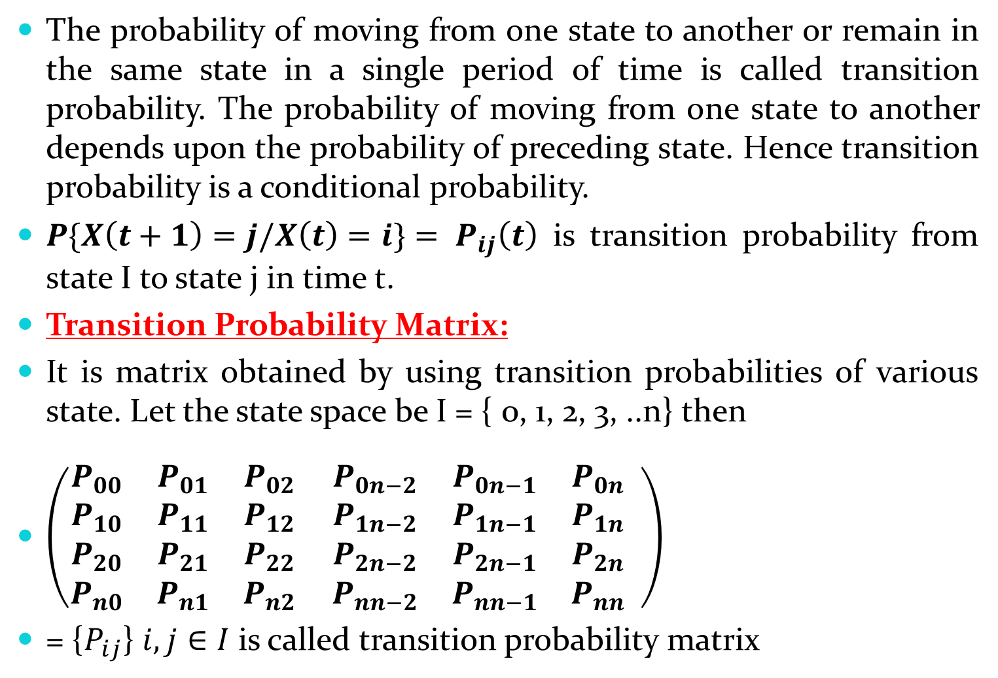
Transition Probability:
The probability of moving from one state to another or remain in the same state in a single period of time is called transition probability. The probability of moving from one state to another depends upon the probability of preceding state. Hence transition probability is a conditional probability.
$P\{X\left(t+1\right)=j/X\left(t\right)=i\}= P_{ij}\left(t\right)$ is transition probability from state I to state j in time t.
Transition Probability Matrix:
It is matrix obtained by using transition probabilities of various state. Let the state space be I = { 0, 1, 2, 3, ..n} then
$\left(\begin{matrix}P_{00} & P_{01} & P_{02} \\ P_{10} & P_{11} & P_{12} \\ \begin{aligned}P_{20} \\ P_{n0}\end{aligned} & \begin{aligned}P_{21} \\ P_{n1}\end{aligned} & \begin{aligned}P_{22} \\ P_{n2}\end{aligned}\end{matrix} \begin{matrix}P_{0n−2} & P_{0n−1} & P_{0n} \\ P_{1n−2} & P_{1n−1} & P_{1n} \\ \begin{aligned}P_{2n−2} \\ P_{nn−2}\end{aligned} & \begin{aligned}P_{2n−1} \\ P_{nn−1}\end{aligned} & \begin{aligned}P_{2n} \\ P_{nn}\end{aligned}\end{matrix} \right)$
= {$P_{ij}$} $i,j∈I$ is called transition probability matrix
Note: $P_{ij}≥0$
$$\sum_{i}{P_{ij}=1}$$
$$\sum_{j}{P_{ij}=1}$$

Slide 9

n Step Transition Probability:
Probability $P_{ij}({t)}^{n}=P\{X\left(t+n\right)=j/X(t)=i\}$ of moving from state I to state j is n step transition probability
$P_{ij}\left(n\right)= \sum_{k=1}^{m}{{P_{ik}}^{(n−1)}}{P_{kj}}^{(1)}$
$P_{ij}\left(2\right)= \sum_{k=1}^{m}{P_{ik}}P_{kj}$
$P_{ij}\left(3\right)= \sum_{k=1}^{m}{\sum_{l=1}^{m}{P_{jk}}P_{kl}P_{lj}}$

Slide 10
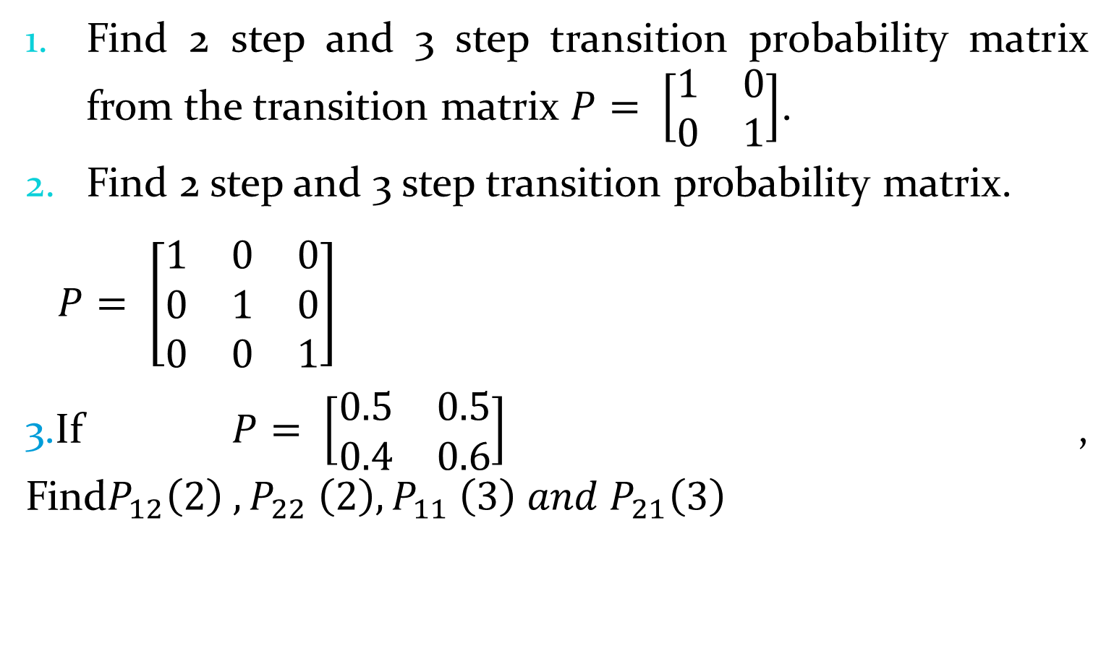
Problems:
Find 2 step and 3 step transition probability matrix from the transition matrix $P= \left[\begin{matrix}1 & 0 \\ 0 & 1\end{matrix}\right]$.
Find 2 step and 3 step transition probability matrix.
$P= \left[\begin{matrix}1 & 0 & 0 \\ 0 & 1 & 0 \\ 0 & 0 & 1\end{matrix}\right]$
3.If $P= \left[\begin{matrix}0.5 & 0.5 \\ 0.4 & 0.6\end{matrix}\right]$ , Find$P_{12}{\left(2\right) , P}_{22}{ \left(2\right), P}_{11}{ \left(3\right) and P}_{21}\left(3\right)$

Slide 11







Problems:
Obtain transition probability matrix from the state transition diagram.
$$\frac{1}{4}$$
$$\frac{1}{2}$$
$$\frac{1}{3}$$
2
1
$$\frac{1}{2}$$
$$\frac{1}{4}$$
3
$$\frac{2}{3}$$
$$\frac{1}{2}$$

Slide 12
Problems:
In some town each day is either sunny or rainy. A sunny day is followed day is followed by another sunny day with probability 0.7, whereas a rainy day is followed by sunny day with probability 0.4. It rains on Monday Make forecast for Tuesday, Wednesday and Thursday.

Slide 13
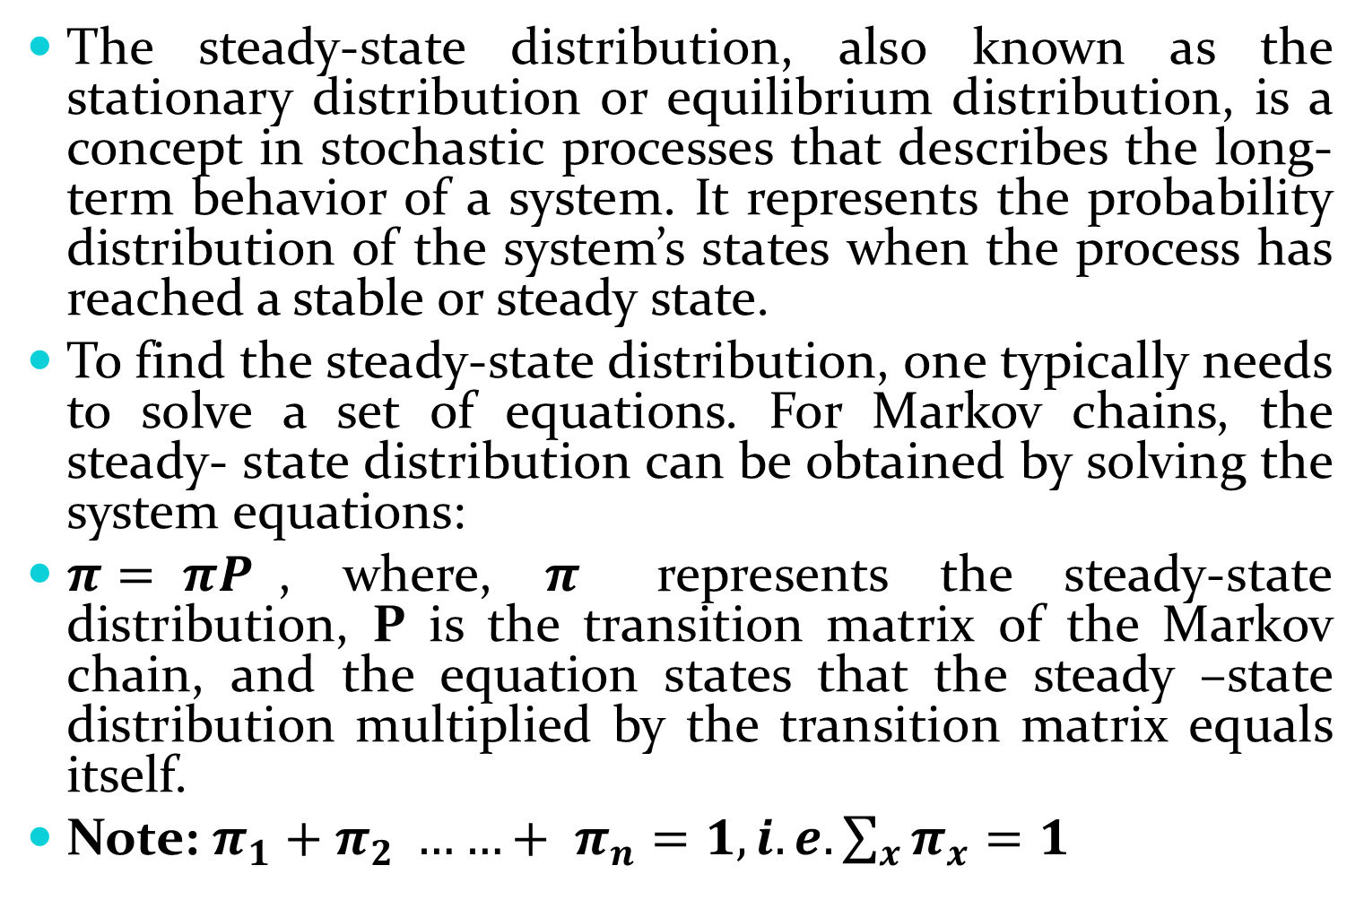
Steady-State Distribution:
The steady-state distribution, also known as the stationary distribution or equilibrium distribution, is a concept in stochastic processes that describes the long-term behavior of a system. It represents the probability distribution of the system’s states when the process has reached a stable or steady state.
To find the steady-state distribution, one typically needs to solve a set of equations. For Markov chains, the steady- state distribution can be obtained by solving the system equations:
$π= πP$, where, $π$ represents the steady-state distribution, P is the transition matrix of the Markov chain, and the equation states that the steady –state distribution multiplied by the transition matrix equals itself.
Note: $π_{1}{+ π}_{2 }{……+ π}_{n}=1, i.e. \sum_{x}{π_{x}=1}$

Slide 14
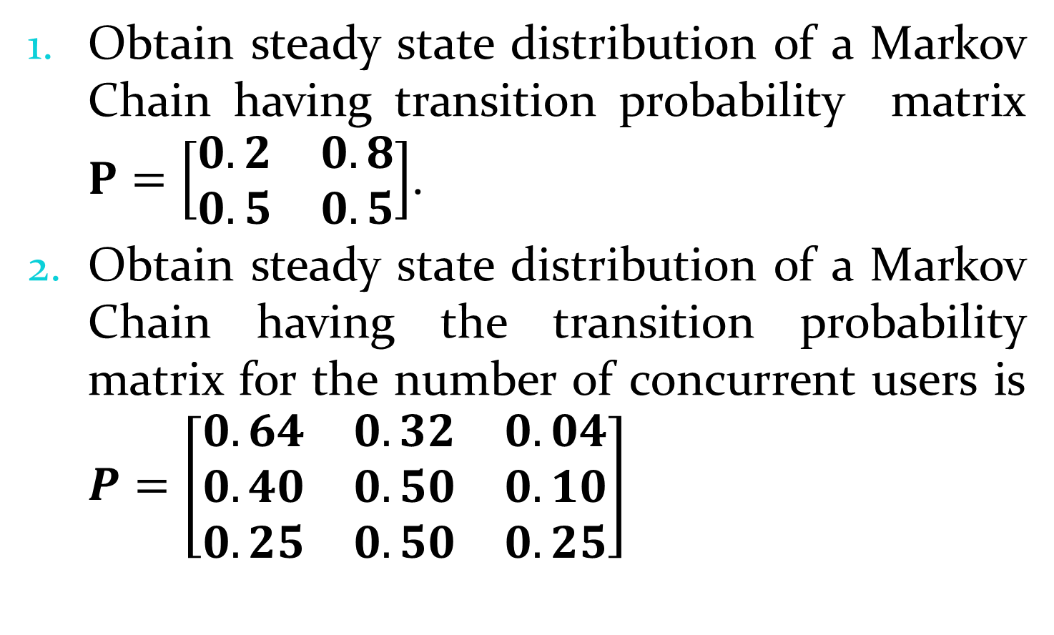
Problems:
Obtain steady state distribution of a Markov Chain having transition probability matrix $P=\left[\begin{matrix}0.2 & 0.8 \\ 0.5 & 0.5\end{matrix}\right]$.
Obtain steady state distribution of a Markov Chain having the transition probability matrix for the number of concurrent users is $P=\left[\begin{matrix}0.64 & 0.32 & 0.04 \\ 0.40 & 0.50 & 0.10 \\ 0.25 & 0.50 & 0.25\end{matrix}\right]$

Slide 15
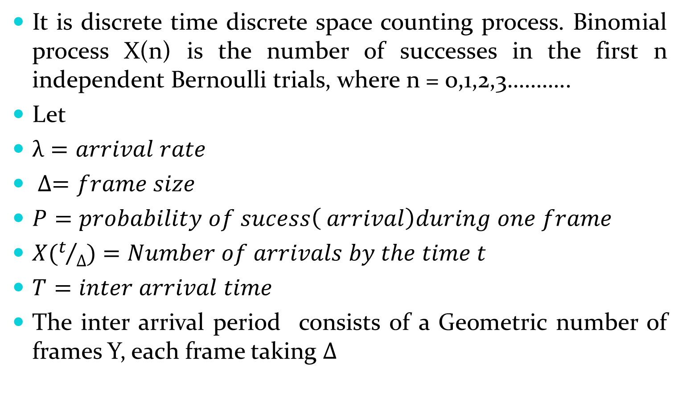
Binomial process:
It is discrete time discrete space counting process. Binomial process X(n) is the number of successes in the first n independent Bernoulli trials, where n = 0,1,2,3………..
Let
$λ=arrival rate$
$∆=frame size$
$P=probability of sucess\left( arrival\right)during one frame$
$X(t/∆)$ $=Number of arrivals by the time t$
$T=inter arrival time$
The inter arrival period consists of a Geometric number of frames Y, each frame taking $∆$

Slide 16
Simulation of stochastic process:
A number of important characteristics of stochastic processes require lengthy complex computations unless they are estimated by means of Monte Carlo methods. One may be interested to explore the time it takes a process to attain a certain level, the time the process spends above some level or above another process, the probability that one process reaches a certain value ahead of another process, etc. Also , it is often important to predict future behavior of a stochastic process.

Slide 17
Queuing System:
A queuing system is facility consisting of one or several servers designed to perform certain tasks or process certain jobs and a queue of jobs waiting to be processed. Jobs arrive at the queuing system, wait for an available server, get processed by this server, and leave.
Example s are
A medical office serving patients.
A printer processing job sent to it from different computers.
A TV channel viewed by many people at various times.
A personal or shared computer executing takes sent by its users.

Slide 18
Features of queue:
Calling population: It is infinite population with independent arrivals and not influenced by queuing system.
Arrival process: Arrival rate follows Poisson distribution with parameter λ.
Queuing configuration: Queue is single waiting line
Queue discipline: Queue discipline is based up on first come first service(FCFS)
Service process: Service rate follows exponential distribution with parameter μ.

Slide 19









Structure of Queuing System:
Customers
SP
1
SP2
Customers Departure
Customers
Arriving
SP
3
Queue or
Waiting line
SP4
Service
facility
Queuing
System

Slide 20
Major components of queuing system:
Customers: The arriving unit that requires some service to be performed. The customers may be persons, machines, vehicles, parts etc.
Queue(Waiting line): The number of customers waiting to be served. The queue does not include the customers being serviced.
Service Provider(Service Channel): The process or facility which is performing the services to the customers. This may be single or multichannel.
Departure(Exit) : This departure component represents the point at which entities leave the system after being processed. It could be customers completing their transaction, tasks finishing their execution.

Slide 21
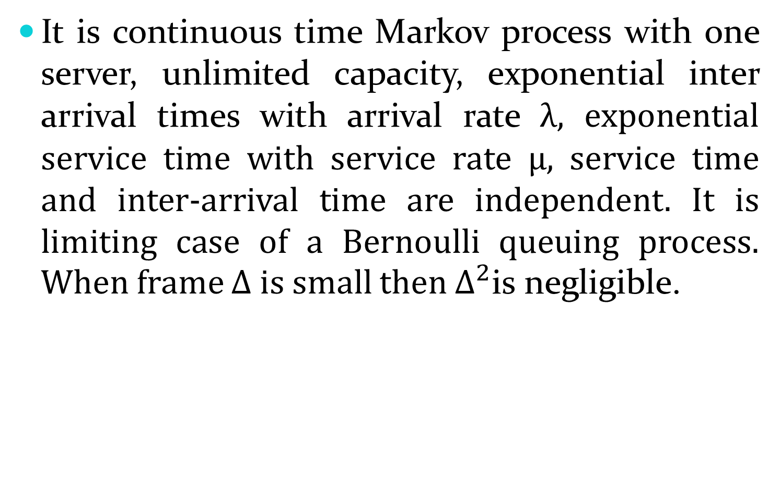
M/M/1 system:
It is continuous time Markov process with one server, unlimited capacity, exponential inter arrival times with arrival rate λ, exponential service time with service rate μ, service time and inter-arrival time are independent. It is limiting case of a Bernoulli queuing process. When frame Δ is small then $∆^{2}$is negligible.
Service Node
λ
µ
Waiting Area
Poisson
Exponential

Slide 22

M/M/1 System:
M/M/1 Queueing System
Arriving
customers
Queue
Single Server
Departing Customers
λ
μ
$$∞$$
Arrival rate = λ
Service rate = µ
Unlimited number of waiting positions

Slide 23
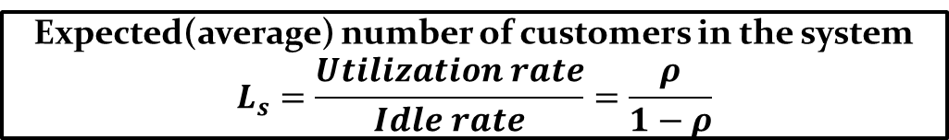

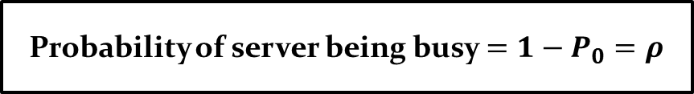
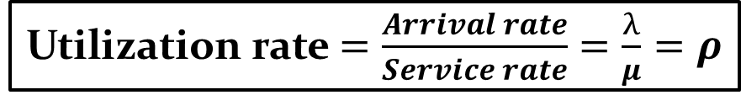
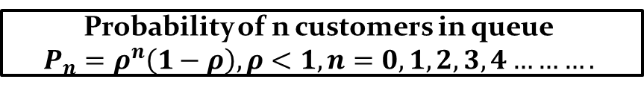
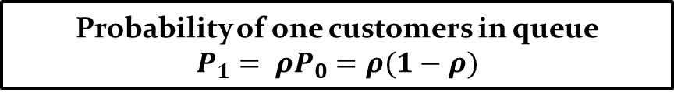

Evaluating the system performance:
Utilization rate $=\frac{Arrival rate}{Service rate}=\frac{λ}{μ}=ρ$
Idle rate $=1−utilization rate=1−ρ$
Probability of no customers in queue
$$P_{0}=1−ρ$$
Probability of one customers in queue
$$P_{1}= ρP_{0}=ρ(1−ρ)$$
Probability of n customers in queue
$$P_{n}=ρ^{n}\left(1−ρ\right), ρ<1, n=0,1,2,3,4……….$$
Probability of server being busy $=1−P_{0}=ρ$
Expected(average) number of customers in the system
$$L_{s}=\frac{Utilization rate}{Idle rate}=\frac{ρ}{1−ρ}$$

Slide 24
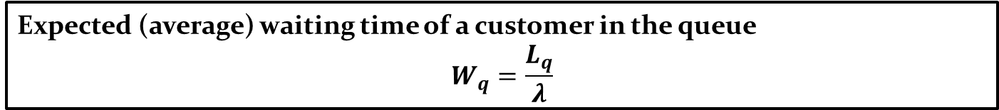
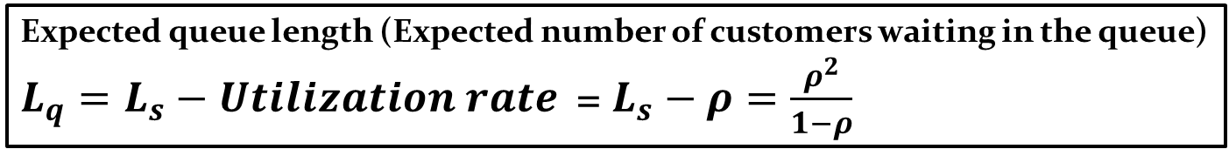
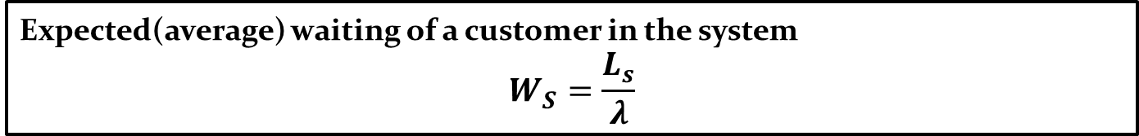
Conti………………………
Expected queue length (Expected number of customers waiting in the queue)
$L_{q}=L_{s}−Utilization rate$= $L_{s}−ρ=\frac{ρ^{2}}{1−ρ}$
Expected (average) waiting time of a customer in the queue
$$W_{q}=\frac{L_{q}}{λ}$$
Expected(average) waiting of a customer in the system
$$W_{S}=\frac{L_{s}}{λ}$$
Probability of k or more customers in the system
$$P\left(n≥k\right)= ρ^{k}$$
Variance of queue length $=V\left(n\right)=\frac{ρ}{{(1−ρ)}^{2}}$
Expected number of customers served per busy period $=L_{b}=\frac{L_{S}}{1−P_{0}}$ $=\frac{1}{1−ρ}$
Expected length of non empty queue $= {L′}_{q}=\frac{L_{q}}{P(n>1)}$

Slide 25
Problems:
In a health clinic, the average rate of arrival of patients is 12 patients per hour. On an average, a doctor can serve patients at the rate of one patients every four minutes. Assume, the arrival of patients follow Poisson distribution and service to patients follows an exponential distribution.
Find the average number of patients in the waiting line and in the clinic
Find the average waiting time in the waiting line or in the queue and
Average waiting time in the clinic.

Slide 26
Problems:
A computer repairman finds that the time spent on his jobs has an exponential distribution with mean 20 minutes. If he repairs sets in an order in which they come in and if the arrival of computers follow Poisson distribution with an average rate of 8 per 6 hour.
Find repairs idle time each day.
Find average number of jobs brought in?
Find variance of queue length.

Slide 27
Problems:
Telephone calls arrive at telephone booth following Poisson distribution at an average time of 5 minutes between one and next. The length of phone call is assumed to be exponentially distributed with an average of 4 minutes.
What is probability that a person arriving at booth will have to wait?
What is average length of queue that forms from time to time?

Slide 28
Problems:
Message arrive to a communication center at random times with an average of 5 message per minute. They are transmitted through a single channel in the order they were received. On average, it takes 10 seconds to transmit a message. Conditions of an M/M/1 queue are satisfied. Compute the main performance characteristics for this center.

Slide 29
Problems:
In supper market, the average arrivals rate of customer is 10 per every 30 minutes following Poisson process. The average time taken by the casher to list and calculate the customers purchase is 2.5 minutes following exponential distribution. What is the probability that queue length exceeds 6. What is the expected time spent by customers in the system?

